Slide 1
Module 14: Common Threats and Attacks
Instructor Materials
CyberOps Associate v1.0
Notes:
Cisco Networking Academy Program
CyberOps Associate v1.0
Module 14: Common Threats and Attacks

Slide 2
Instructor Materials – Module 14 Planning Guide
This PowerPoint deck is divided in two parts:
Instructor Planning Guide
Information to help you become familiar with the module
Teaching aids
Instructor Class Presentation
Optional slides that you can use in the classroom
Begins on slide # 9
Note: Remove the Planning Guide from this presentation before sharing with anyone.
For additional help and resources go to the Instructor Home Page and Course Resources for this course. You also can visit the professional development site on www.netacad.com, the official Cisco Networking Academy Facebook page, or Instructor Only FB group.
Notes:
2

Slide 3
What to Expect in this Module
To facilitate learning, the following features within the GUI may be included in this module:
Feature | Description
Animations | Expose learners to new skills and concepts.
Videos | Expose learners to new skills and concepts.
Check Your Understanding(CYU) | Per topic online quiz to help learners gauge content understanding.
Hands-On Labs | Labs designed for working with physical equipment.
Module Quizzes | Self-assessments that integrate concepts and skills learned throughout the series of topics presented in the module.

Slide 4
Check Your Understanding
Check Your Understanding activities are designed to let students quickly determine if they understand the content and can proceed, or if they need to review.
Check Your Understanding activities do not affect student grades.
There are no separate slides for these activities in the PPT. They are listed in the notes area of the slide that appears before these activities.
Notes:
4

Slide 5
Module 14: Activities
What activities are associated with this module?
Page # | Activity Type | Activity Name | Optional?
14.1.1 | Animation | Types of Malware | Recommended
14.1.6 | Animation | Worm Components | Recommended
14.1.10 | Check Your Understanding | Malware | Recommended
14.1.11 | Lab | Anatomy of Malware | Recommended
14.2.2 | Animation | Reconnaissance Attacks | Recommended
14.2.3 | Video | Reconnaissance Attacks | Recommended
14.2.4 | Animation | Access Attacks | Recommended
Notes:
5

Slide 6
Module 14: Activities (Contd.)
What activities are associated with this module?
Page # | Activity Type | Activity Name | Optional?
14.2.5 | Video | Access and Social Engineering Attacks | Recommended
14.2.8 | Lab | Social Engineering | Recommended
14.3.1 | Video | Denial of Service Attacks | Recommended
14.3.2 | Animation | DoS and DDoS Attacks
14.3.4 | Video | Mirai Botnet | Recommended
14.3.7 | Check Your Understanding | Identify the Types of Network Attacks | Recommended
Notes:
6

Slide 7
Module 14: Best Practices
Prior to teaching Module 14, the instructor should:
Review the activities and assessments for this module.
Try to include as many questions as possible to keep students engaged during classroom presentation.
Topic 14.1
Ask the class:
What are the types of malware?
How are viruses spread?
What is ransomware?
Where are trojans often found?
What is the difference between virus and worms?
Notes:
7

Slide 8
Module 14: Best Practices (Cont.)
Topic 14.2
Discuss the types of network attacks
Identify the differences between reconnaissance, access and social engineering attacks
Topic 14.3
Explain Mirai Botnet.
Ask the class what is Buffer Overflow Attack?
Discuss the evasion methods
Notes:
8

Slide 9
Module 14: Common Threats and Attacks
CyberOps Associate v1.0
Notes:
Cisco Networking Academy Program
CyberOps Associate v1.0
Module 14: Common Threats and Attacks
In-Session Activities / Explanations:
Time: 5 min
Instructor Notes:
Welcome the audience in a warm and cordial manner. Ensure that everyone is set up with the required resources.
Introduce yourself briefly and invite participants to introduce themselves with name, dept. and role, if deemed all right.
Introduce the topic and encourage learners to come up with a list of expectations from the session. Collate topics on the white board or Desktop while using learner’s inputs to interpret them in words.
Read out the Objectives and briefly describe each.
Key Points: NA

Slide 10
Module Objectives
Module Title: Common Threats and Attacks
Module Objective: Explain the various types of threats and attacks.
Topic Title | Topic Objective
Malware | Describe types of malware.
Common Network Attacks - Reconnaissance, Access, and Social Engineering | Explain reconnaissance, access, and social engineering network attacks.
Network Attacks - Denial of Service, Buffer Overflows, and Evasion | Explain Denial of Service, buffer overflow, and evasion attacks.
Notes:
10
14 – Common Threats and Attacks
14.0 – Introduction
14.0.2 – What Will I Learn in this Module?

Slide 11
14.1 Malware
Notes:
Source:
14 – Common Threats and Attacks
14.1 – Malware
In-Session Activities / Explanations:
Time: 22 min
Instructor Notes:
Ask the students the following questions before you begin to explain the different types of malware:
Have your computers or networks ever crashed?
Have you ever wondered what might be the reason behind the damage or disruption of networks?
Where does malware originate from?
Demonstrate the animation to the students and explain the different examples of malware.
Demonstrate the animation to the students to explain the components of worm attacks.
Ensure they complete the ‘Check Your Understanding – Malware’ in section 14.1.10.
At the end of the topic, present different scenarios or examples of each type of malware to the students and ask them to identify.
Key Points: Viruses, Trojan horses, Worm, Ransomware, Malware Behaviors.

Slide 12
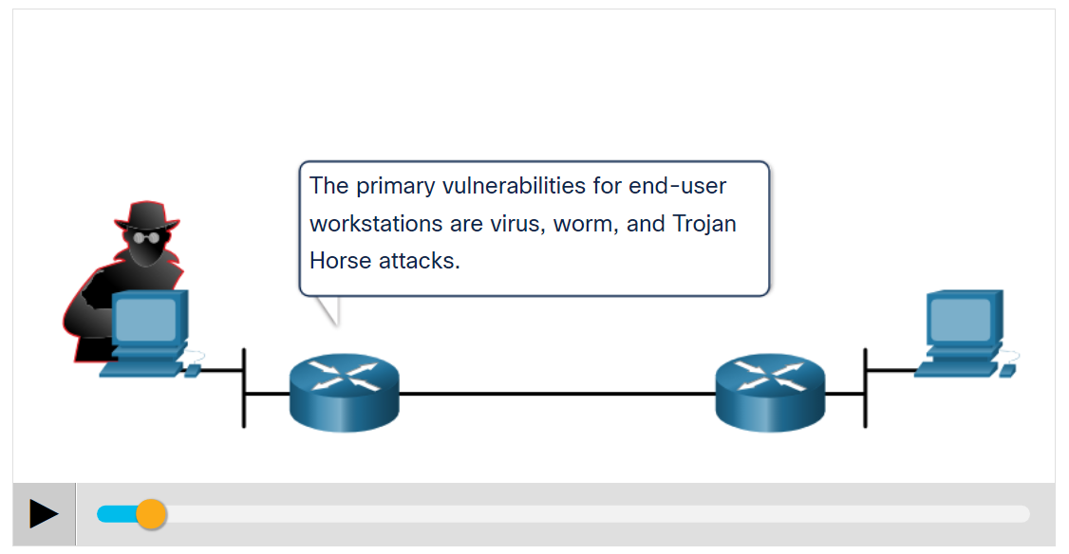
Common Threats and Attacks Types of Malware
Malware is a code or software designed to damage, disrupt, steal, or inflict some other ‘bad’ or illegitimate action on data, hosts, or networks.
The three most common types of malware are Virus, Worm, and Trojan horse.
Play the animation to view examples of the different malware types.
Notes:
14 – Common Threats and Attacks
14.1 – Malware
14.1.1 – Types of Malware

Slide 13
Common Threats and Attacks Viruses
A virus is a type of malware that spreads by inserting a copy of itself into another program.
After the program is run, viruses spread from one computer to another, thus infecting the computers.
A simple virus may install itself at the first line of code in an executable file.
Viruses can be harmless, for those that display a picture on the screen, or they can be destructive. They can also modify or delete files on the hard drive.
Most viruses spread by USB memory drives, CDs, DVDs, network shares, and email. Email viruses are a common type of virus.
Notes:
14 – Common Threats and Attacks
14.1 – Malware
14.1.2 – Viruses

Slide 14
Common Threats and Attacks Trojan Horses
Trojan horse malware is a software that appears to be legitimate, but it contains malicious code which exploits the privileges of the user that runs it.
Trojans are found attached to online games.
Users are commonly tricked into loading and executing the Trojan horse on their systems
The Trojan horse concept is flexible.
It can cause immediate damage, provide remote access to the system, or access through a back door.
Custom-written Trojan horses with a specific target are difficult to detect.
Notes:
14 – Common Threats and Attacks
14.1 – Malware
14.1.3 – Trojan Horses

Slide 15
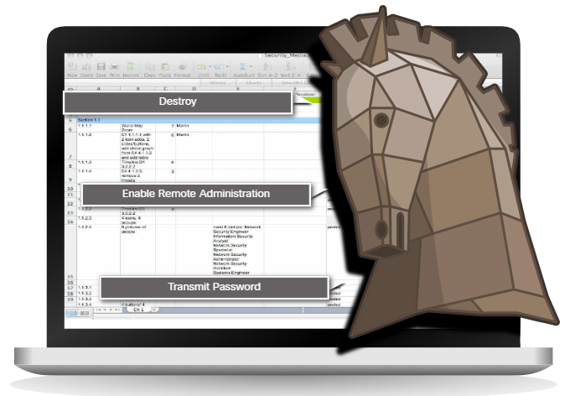
Common Threats and Attacks Trojan Horses Classification
Trojan horses are usually classified according to the damage that they cause, or the manner in which they breach a system.
Notes:
14 – Common Threats and Attacks
14.1 – Malware
14.1.4 – Trojan Horse Classification

Slide 16
Common Threats and Attacks Trojan Horses Classification (Contd.)
The types of Trojan horses are as follows:
Type of Trojan Horse | Description
Remote-access | Enables unauthorized remote access.
Data-sending | Provides the threat actor with sensitive data, such as passwords.
Destructive | Corrupts or deletes files.
Proxy | Uses the victim's computer as the source device to launch attacks and perform other illegal activities.
FTP | Enables unauthorized file transfer services on end devices.
Security software disabler | Stops antivirus programs or firewalls from functioning.
Denial of Service (DoS) | Slows or halts network activity.
Keylogger | Actively attempts to steal confidential information, such as credit card numbers, by recording keystrokes entered into a web form.
Notes:
14 – Common Threats and Attacks
14.1 – Malware
14.1.4 – Trojan Horse Classification

Slide 17
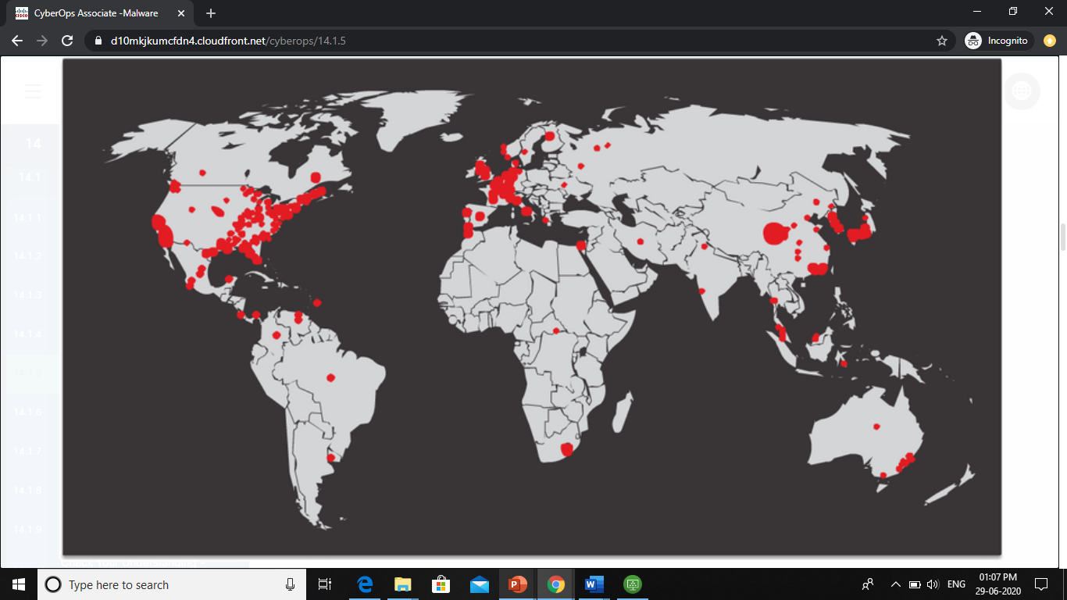
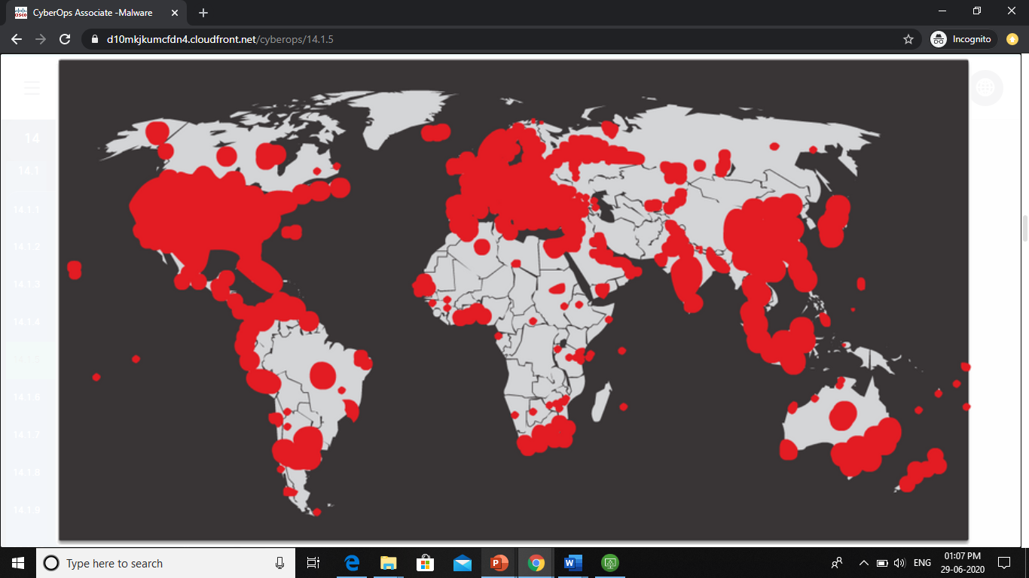
Common Threats and Attacks Worms
Computer worms are similar to viruses because they replicate themselves by independently exploiting vulnerabilities in networks.
Worms can slow down networks as they spread from system to system.
Worms can run without a host program.
However, once the host is infected, the worm spreads rapidly over the network.
In 2001, the Code Red worm had initially infected 658 servers. Within 19 hours, the worm had infected over 300,000 servers.
Initial Code Red Worm Infection
Code Red Infection 19 hours later
Notes:
14 – Common Threats and Attacks
14.1 – Malware
14.1.5 – Worms

Slide 18
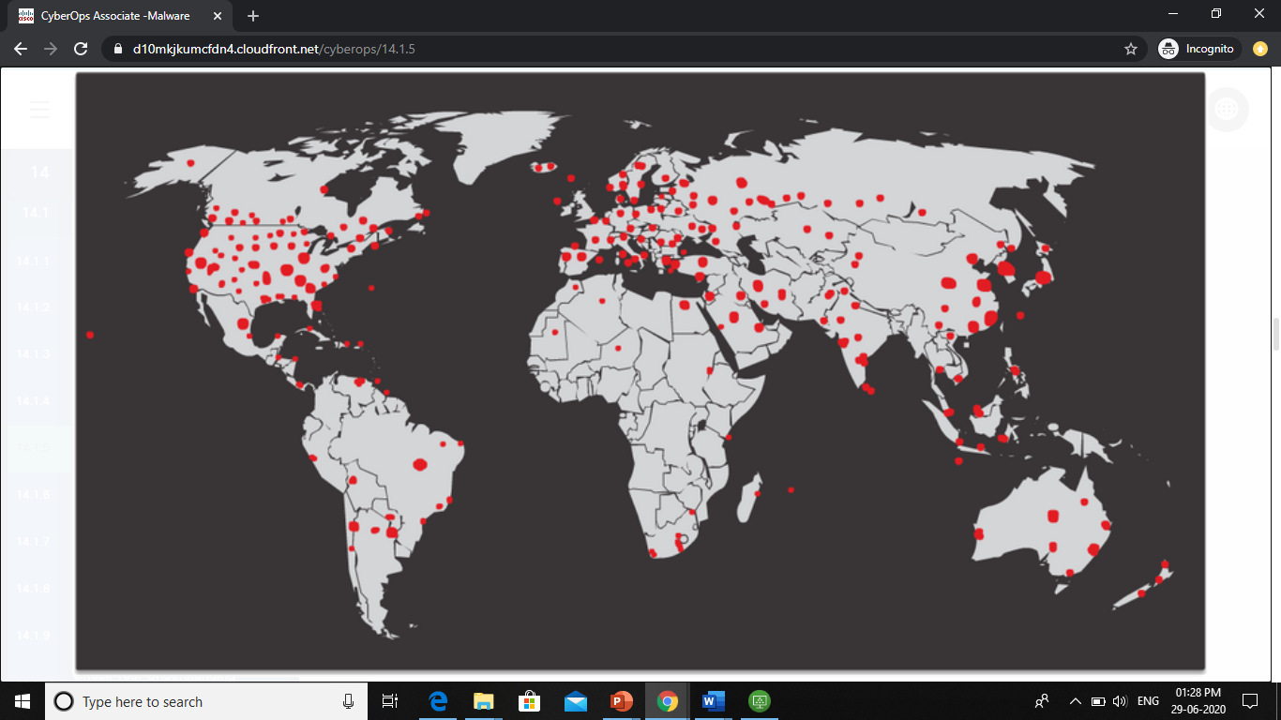
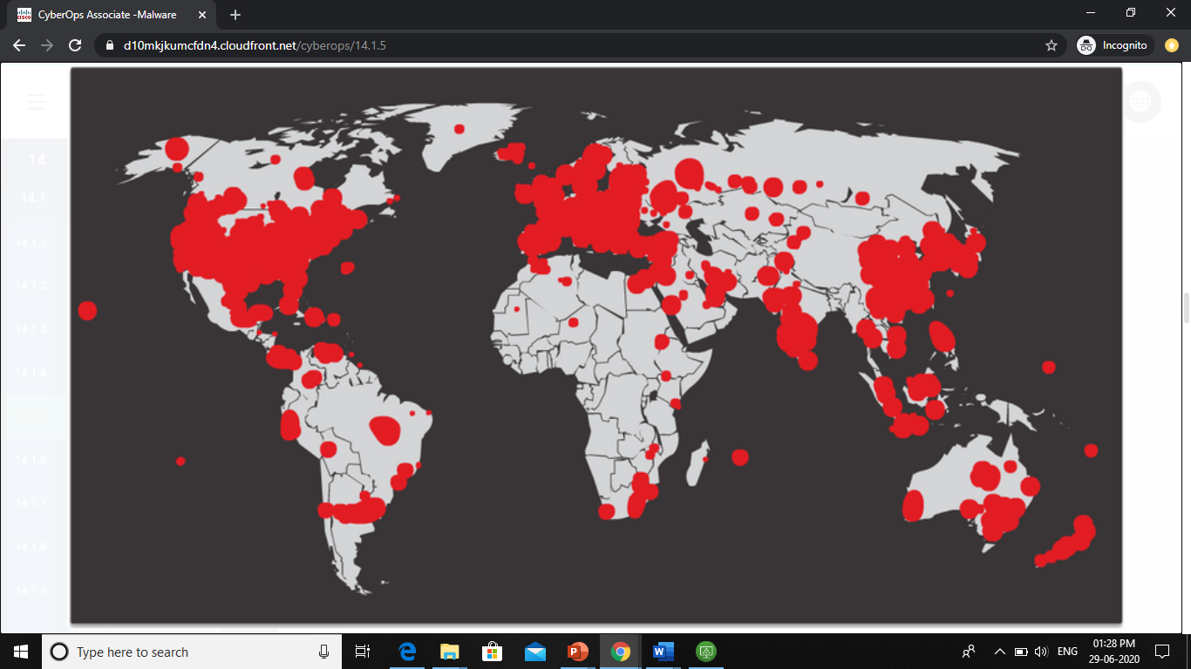
Common Threats and Attacks Worms (Contd.)
The initial infection of the SQL Slammer worm is known as the worm that ate the internet.
SQL Slammer was a Denial of Service (DoS) attack that exploited a buffer overflow bug in Microsoft’s SQL Server.
The number of infected servers doubled in size every 8.5 seconds.
The infected servers did not have the updated patch that was released 6 months earlier.
Hence it is essential for organizations to implement a security policy requiring updates and patches to be applied in a timely fashion.
Initial SQL Slammer Infection
SQL Slammer Infection 30 minutes later
Notes:
14 – Common Threats and Attacks
14.1 – Malware
14.1.5 – Worms

Slide 19
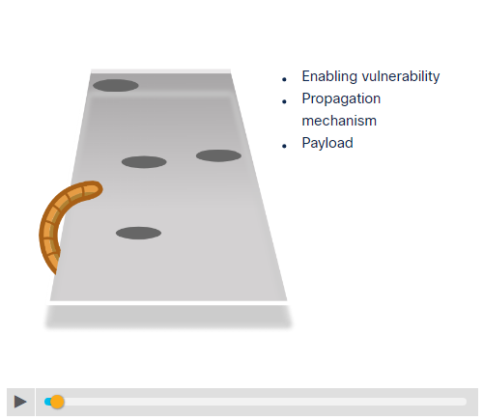
Common Threats and Attacks Worm Components
Click Play in the figure to view the three components of worm attacks.
Notes:
14 – Common Threats and Attacks
14.1 – Malware
14.1.6 – Worm Components

Slide 20
Common Threats and Attacks Worm Components (Contd.)
The three worm components are as follows:
Enabling vulnerability - A worm installs itself using an exploit mechanism, such as an email attachment, an executable file, or a Trojan horse, on a vulnerable system.
Propagation mechanism - After gaining access to a device, the worm replicates itself and locates new targets.
Payload - Any malicious code that results in some action is a payload. Most often this is used to create a backdoor that allows a threat actor to access the infected host or to create a DoS attack.
Notes:
14 – Common Threats and Attacks
14.1 – Malware
14.1.6 – Worm Components

Slide 21
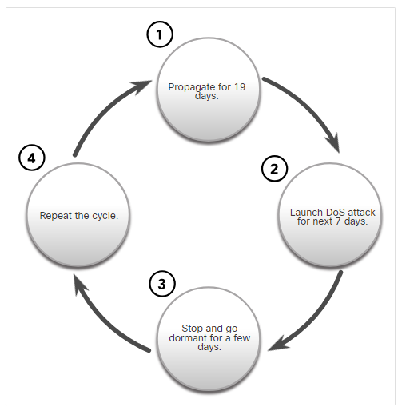
Common Threats and Attacks Worm Components (Contd.)
Worms are self-contained programs that attack a system to exploit a known vulnerability.
Upon successful exploitation, the worm copies itself from the attacking host to the newly exploited system and the cycle begins again.
This propagation mechanism is commonly deployed in a way that is difficult to detect.
Note: Worms never stop spreading on the internet. After they are released, worms continue to propagate until all possible sources of infection are properly patched.
Code Red Worm Propagation
Notes:
14 – Common Threats and Attacks
14.1 – Malware
14.1.6 – Worm Components

Slide 22
Common Threats and Attacks Ransomware
Ransomware is a malware that denies access to the infected computer system or its data.
Ransomware frequently uses an encryption algorithm to encrypt system files and data.
Email and malicious advertising, also known as malvertising, are vectors for ransomware campaigns.
Social engineering is also used, when cybercriminals pretending to be security technicians make random calls at homes and persuade users to connect to a website that downloads ransomware to the user’s computer.
Notes:
14 – Common Threats and Attacks
14.1 – Malware
14.1.7 – Ransomware

Slide 23
Common Threats and Attacks Other Malware
The examples of modern malware are as follows:
Type of Malware | Description
Scareware | Includes scam software which uses social engineering to shock or induce anxiety by creating the perception of a threat. It is generally directed at an unsuspecting user and attempts to persuade the user to infect a computer by taking action to address the bogus threat.
Phishing | Attempts to convince people to divulge sensitive information. Examples include receiving an email from their bank asking users to divulge their account and PIN numbers.
Rootkits | Installed on a compromised system. After it is installed, it continues to hide its intrusion and provide privileged access to the threat actor.
Spyware | Used to gather information about a user and send the information to another entity without the user’s consent. Spyware can be a system monitor, Trojan horse, Adware, tracking cookies, and key loggers.
Adware | Displays annoying pop-ups to generate revenue for its author. The malware may analyze user interests by tracking the websites visited. It can then send pop-up advertising pertinent to those sites.
Notes:
14 – Common Threats and Attacks
14.1 – Malware
14.1.8 – Other Malware

Slide 24
Common Threats and Attacks Common Malware Behaviors
Computers infected with malware often exhibit one or more of the following symptoms:
Appearance of strange files, programs, or desktop icons
Antivirus and firewall programs are turning off or reconfiguring settings
Computer screen is freezing or system is crashing
Emails are spontaneously being sent without your knowledge to your contact list
Files have been modified or deleted
Increased CPU and/or memory usage
Problems connecting to networks
Slow computer or web browser speeds
Unknown processes or services running
Unknown TCP or UDP ports open
Connections are made to hosts on the Internet without user action
Strange computer behavior
Note: Malware behavior is not limited to the above list.
Notes:
14 – Common Threats and Attacks
14.1 – Malware
14.1.9 – Common Malware Behaviors
14.1.10 – Check Your Understanding - Malware

Slide 25
Common Threats and Attacks Lab – Anatomy of Malware
In this lab, you will research and analyze some recent malware.
Notes:
14 – Common Threats and Attacks
14.1 – Malware
14.1.11 – Lab – Anatomy of Malware

Slide 26
14.2 Common Network Attacks - Reconnaissance, Access, and Social Engineering
Notes:
Source:
14 – Common Threats and Attacks
14.2 – Common Network Attacks - Reconnaissance, Access, and Social Engineering
In-Session Activities / Explanations:
Time: 10min
Instructor Notes:
Explain the learners how are networks attacked and list down it’s different types.
Explain the progress of a reconnaissance attack using the animation in 14.2.2.
Briefly discuss Reconnaissance Attacks and ask the students to view the video in 14.2.3.
Illustrate and explain the access attacks using animations in 14.2.4.
Demonstrate the types of access and social engineering attacks using the video in 14.2.5.
Describe the concept of ‘strengthening the weakest link’ to the learners.
Guide them to identify the ways to recognize and prevent Social Engineering.
Key Points: Reconnaissance Attacks, Access Attacks, DoS Attacks

Slide 27
Common Network Attacks - Reconnaissance, Access, and Social Engineering Types of Network Attacks
Malware is a means to get a payload delivered .
When a payload is delivered and installed, it can be used to cause a variety of network-related attacks from the inside as well as from the outside.
Network attacks are classified into three categories:
Reconnaissance Attacks
Access Attacks
DoS Attacks
Notes:
14 – Common Threats and Attacks
14.2 – Common Network Attacks - Reconnaissance, Access, and Social Engineering
14.2.1 – Types of Network Attacks

Slide 28
Common Network Attacks - Reconnaissance, Access, and Social Engineering Reconnaissance Attacks
Reconnaissance is information gathering.
Threat actors use reconnaissance (or recon) attacks to do unauthorized discovery and mapping of systems, services, or vulnerabilities.
Recon attacks precede access attacks or DoS attacks.
Notes:
14 – Common Threats and Attacks
14.2 – Common Network Attacks - Reconnaissance, Access, and Social Engineering
14.2.2 – Reconnaissance Attacks

Slide 29
Common Network Attacks - Reconnaissance, Access, and Social Engineering Reconnaissance Attacks (Contd.)
The techniques used by malicious threat actors to conduct reconnaissance attacks are as follows:
Technique | Description
Perform an information query of a target | The threat actor is looking for initial information about a target. Various tools can be used, including the Google search, organizations website, whois, and more.
Initiate a ping sweep of the target network | The information query usually reveals the target’s network address. The threat actor can now initiate a ping sweep to determine which IP addresses are active.
Initiate a port scan of active IP addresses | This is used to determine which ports or services are available. Examples of port scanners include Nmap, SuperScan, Angry IP Scanner, and NetScanTools.
Run vulnerability scanners | This is to query the identified ports to determine the type and version of the application and operating system that is running on the host. Examples of tools include Nipper, Secuna PSI, Core Impact, Nessus v6, SAINT, and Open VAS.
Run exploitation tools | The threat actor now attempts to discover vulnerable services that can be exploited. A variety of vulnerability exploitation tools exist including Metasploit, Core Impact, Sqlmap, Social Engineer Toolkit, and Netsparker.
Notes:
14 – Common Threats and Attacks
14.2 – Common Network Attacks - Reconnaissance, Access, and Social Engineering
14.2.2 – Reconnaissance Attacks

Slide 30
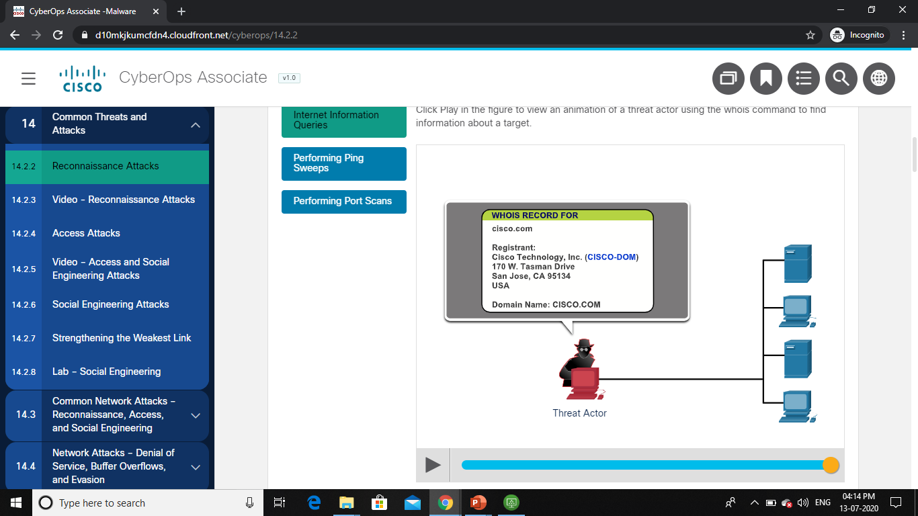
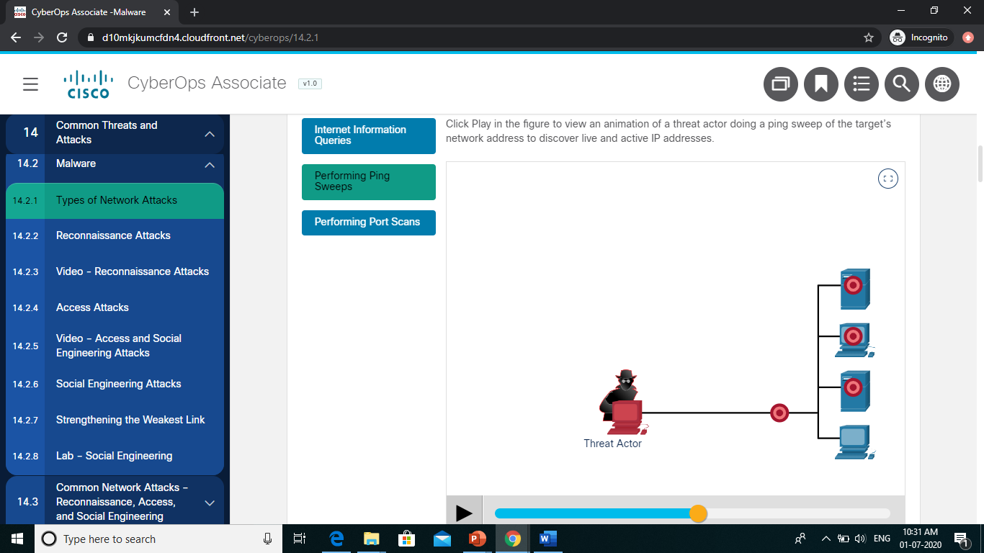
Common Network Attacks - Reconnaissance, Access, and Social Engineering Reconnaissance Attacks (Contd.)
Internet Information Queries: Click Play in the figure to view an animation of a threat actor using the who is command to find information about a target.
Performing Ping Sweep: Click Play in the figure to view an animation of a threat actor doing a ping sweep of the target’s network address to discover live and active IP addresses.
Notes:
14 – Common Threats and Attacks
14.2 – Common Network Attacks - Reconnaissance, Access, and Social Engineering 14.2.2 – Reconnaissance Attacks

Slide 31
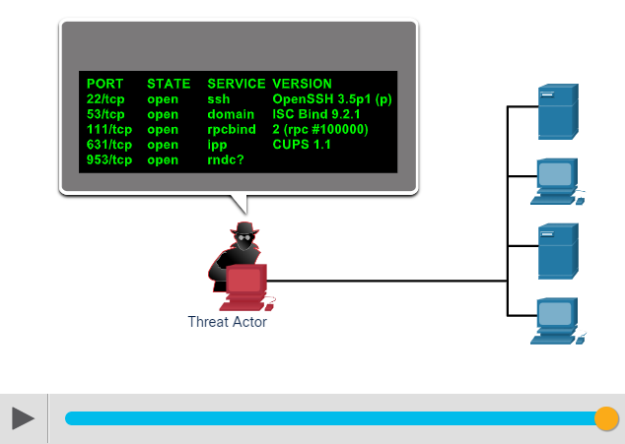
Common Network Attacks - Reconnaissance, Access, and Social Engineering Reconnaissance Attacks (Contd.)
Performing Port Scan: Click Play in the figure to view an animation of a threat actor performing a port scan on the discovered active IP addresses using Nmap.
Notes:
14 – Common Threats and Attacks
14.2 – Common Network Attacks - Reconnaissance, Access, and Social Engineering 14.2.2 – Reconnaissance Attacks

Slide 32
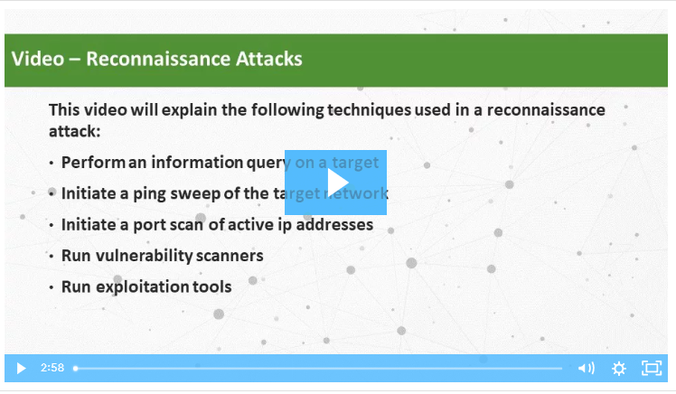
Common Network Attacks - Reconnaissance, Access, and Social Engineering Video - Reconnaissance Attacks
Watch the video to learn about the different techniques in a reconnaissance attack.
Notes:
14 – Common Threats and Attacks
14.2 – Common Network Attacks - Reconnaissance, Access, and Social Engineering 14.2.3 – Video - Reconnaissance Attacks

Slide 33
Common Network Attacks - Reconnaissance, Access, and Social Engineering Access Attacks
Access attacks exploit known vulnerabilities in authentication services, FTP services, and web services to gain entry into web accounts, confidential databases, and other sensitive information.
Password Attacks
The threat actor attempts to discover critical system passwords using a variety of password cracking tools.
Spoofing Attacks
The threat actor device attempts to pose as another device by falsifying data.
Common spoofing attacks include IP spoofing, MAC spoofing, and DHCP spoofing.
Trust exploitations
Port redirections
Man-in-the-middle attacks
Buffer overflow attacks
Notes:
14 – Common Threats and Attacks
14.2 – Common Network Attacks - Reconnaissance, Access, and Social Engineering 14.2.4 – Access Attacks

Slide 34
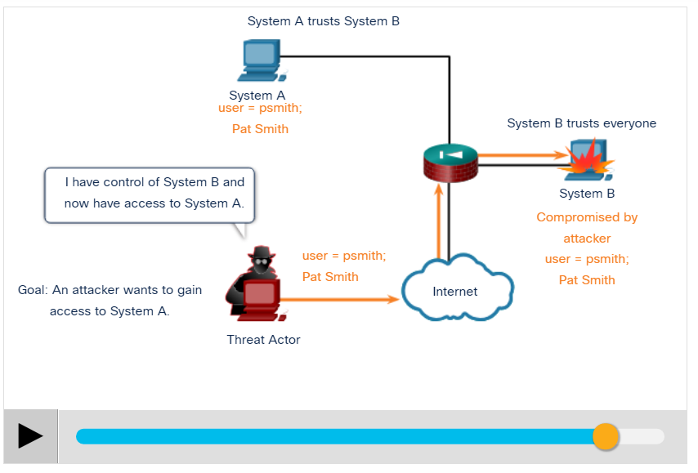
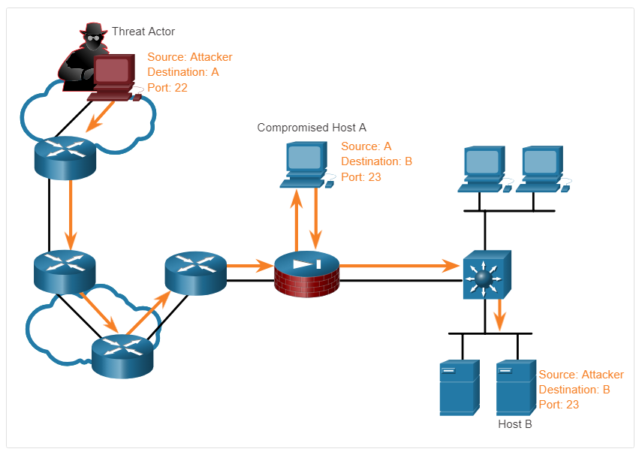
Common Network Attacks - Reconnaissance, Access, and Social Engineering Access Attacks (Contd.)
Trust Exploitation Example: Click Play in the figure to view an example of trust exploitation.
Port Redirection Example: The example shows a threat actor using SSH (port 22) to connect to a compromised Host A trusted by Host B. Hence, the threat actor can use Telnet (port 23) to access it.
Notes:
14 – Common Threats and Attacks
14.2 – Common Network Attacks - Reconnaissance, Access, and Social Engineering 14.2.4 – Access Attacks

Slide 35
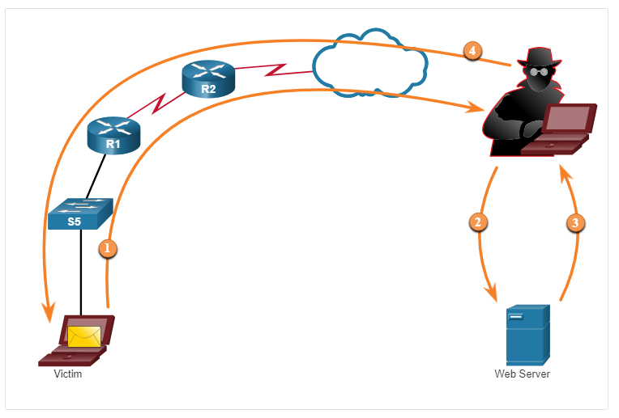
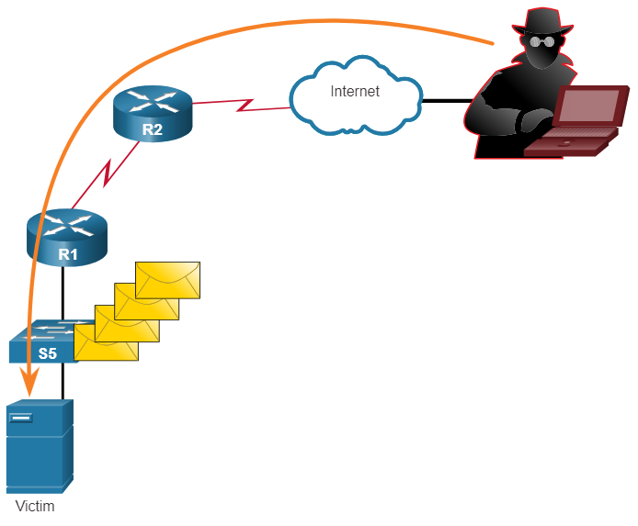
Common Network Attacks - Reconnaissance, Access, and Social Engineering Access Attacks (Contd.)
Man-in-the-Middle Attack Example: The figure displays an example of a man-in-the-middle attack.
Buffer Overflow Attack: The figure shows that the threat actor is sending many packets to the victim in an attempt to overflow the victim’s buffer.
Notes:
14 – Common Threats and Attacks
14.2 – Common Network Attacks - Reconnaissance, Access, and Social Engineering 14.2.4 – Access Attacks

Slide 36
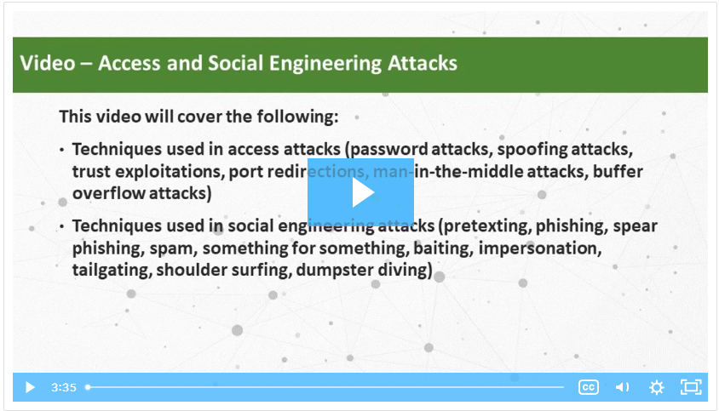
Common Network Attacks - Reconnaissance, Access, and Social Engineering Video - Access and Social Engineering Attacks
Watch the video to see the demonstration of the types of access and social engineering attacks.
Notes:
14 – Common Threats and Attacks
14.2 – Common Network Attacks - Reconnaissance, Access, and Social Engineering 14.2.5 – Video - Access and Social Engineering Attacks

Slide 37
Common Network Attacks - Reconnaissance, Access, and Social Engineering Social Engineering Attacks
Social Engineering is an access attack that attempts to manipulate individuals into performing actions or divulging into confidential information.
Some social engineering techniques are performed in-person or via the telephone or internet.
Social engineering techniques are explained in the below table.
Social Engineering Attack | Description
Pretexting | A threat actor pretends to need personal or financial data to confirm the identity of the recipient.
Phishing | A threat actor sends fraudulent email which is disguised as being from a legitimate, trusted source to trick the recipient into installing malware on their device, or to share personal or financial information.
Spear phishing | A threat actor creates a targeted phishing attack tailored for a specific individual or organization.
Spam | Also known as junk mail, this is unsolicited email which often contains harmful links, malware, or deceptive content.
Notes:
14 – Common Threats and Attacks
14.2 – Common Network Attacks - Reconnaissance, Access, and Social Engineering 14.2.6 – Social Engineering Attacks

Slide 38
Common Network Attacks - Reconnaissance, Access, and Social Engineering Social Engineering Attacks (Contd.)
Social Engineering Attack | Description
Something for Something | Sometimes called “Quid pro quo”, this is when a threat actor requests personal information from a party in exchange for something such as a gift.
Baiting | A threat actor leaves a malware infected flash drive in a public location. A victim finds the drive and unsuspectingly inserts it into their laptop, unintentionally installing malware.
Impersonation | In this type of attack, a threat actor pretends to be someone else to gain the trust of a victim.
Tailgating | This is where a threat actor quickly follows an authorized person into a secure location to gain access to a secure area.
Shoulder surfing | This is where a threat actor inconspicuously looks over someone’s shoulder to steal their passwords or other information.
Dumpster diving | This is where a threat actor rummages through trash bins to discover confidential documents.
Notes:
14 – Common Threats and Attacks
14.2 – Common Network Attacks - Reconnaissance, Access, and Social Engineering 14.2.6 – Social Engineering Attacks

Slide 39
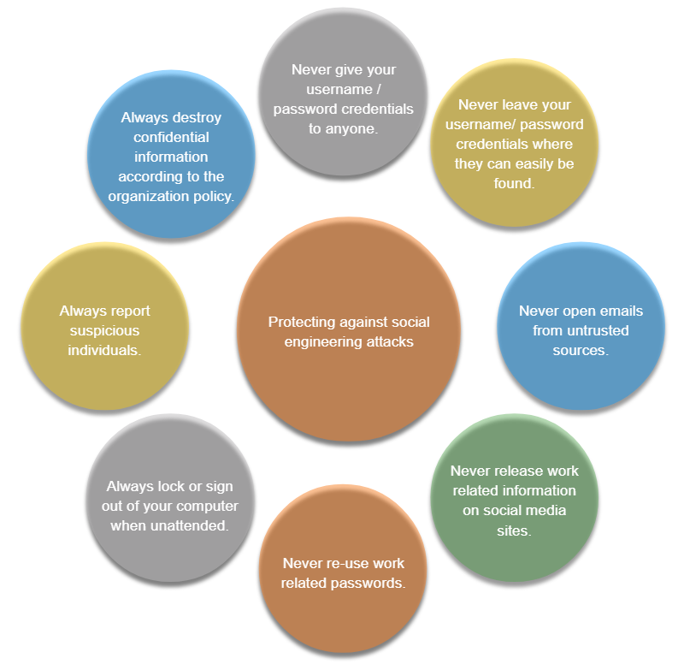
Common Network Attacks - Reconnaissance, Access, and Social Engineering Social Engineering Attacks (Contd.)
The Social Engineer Toolkit (SET) was designed to help white hat hackers and other network security professionals to create social engineering attacks to test their own networks.
Enterprises must educate their users about the risks of social engineering, and develop strategies to validate identities over the phone, via email, or in person.
Social Engineering Protection Practices
Notes:
14 – Common Threats and Attacks
14.2 – Common Network Attacks - Reconnaissance, Access, and Social Engineering 14.2.6 – Social Engineering Attacks

Slide 40
Common Network Attacks - Reconnaissance, Access, and Social Engineering Strengthening the Weakest Link
Cybersecurity is as strong as its weakest link.
The weakest link in cybersecurity can be the personnel within an organization, and social engineering is a major security threat.
One of the most effective security measures that an organization can take is to train its personnel and create a ‘security-aware culture’.
Notes:
14 – Common Threats and Attacks
14.2 – Common Network Attacks - Reconnaissance, Access, and Social Engineering 14.2.7 – Strengthening the Weakest Link

Slide 41
Common Network Attacks - Reconnaissance, Access, and Social Engineering Lab – Social Engineering
In this lab, you will research examples of social engineering and identify ways to recognize and prevent it.
Notes:
14 – Common Threats and Attacks
14.1 – Common Network Attacks - Reconnaissance, Access, and Social Engineering 14.2.8 – Lab – Social Engineering

Slide 42
14.3 Network Attacks - Denial of Service, Buffer Overflows, and Evasion
Notes:
Source:
14 – Common Threats and Attacks
14.3 – Network Attacks - Denial of Service, Buffer Overflows, and Evasion
In-Session Activities / Explanations:
Time: 10 mins
Instructor Notes:
Demonstrate the video in 14.3.1 and explain the different techniques used in Denial of Service Attack.
Explain and illustrate examples of DoS and DDoS attacks by playing animations covered in 14.3.2.
Provide a short background of Mirai Botnet Attack and later play the video in 14.3.4.
Discuss the Buffer Overflow Attack and Evasion methods.
Ensure they complete the ‘Check Your Understanding – Identify the Types of Network Attacks’ in section 14.3.7.
Key Points: DoS and DDoS attacks, Mirai Botnet attack, Buffer Overflow attack, Evasion Methods.

Slide 43
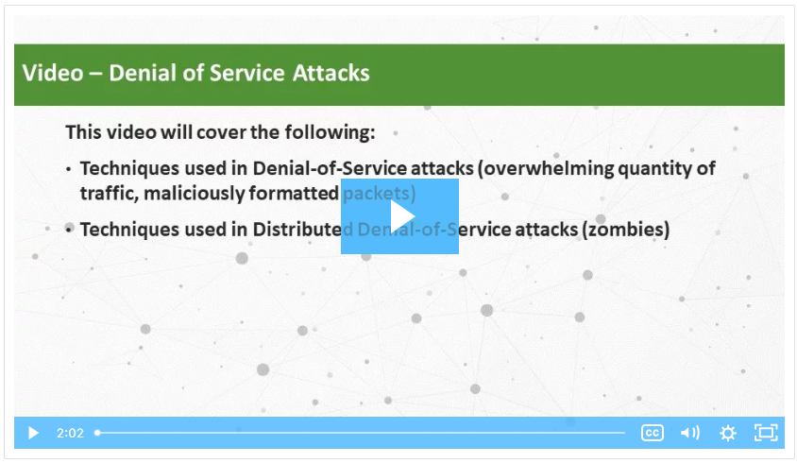
Network Attacks - Denial of Service, Buffer Overflows, and Evasion Video – Denial of Service Attacks
Watch the video to learn about Denial of Service attacks.
Notes:
14 – Common Threats and Attacks
14.3 – Network Attacks - Denial of Service, Buffer Overflows, and Evasion
14.3.1 – Video - Denial of Service Attacks

Slide 44
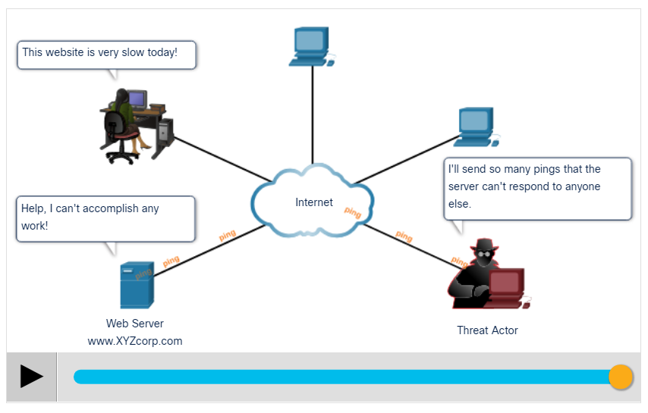
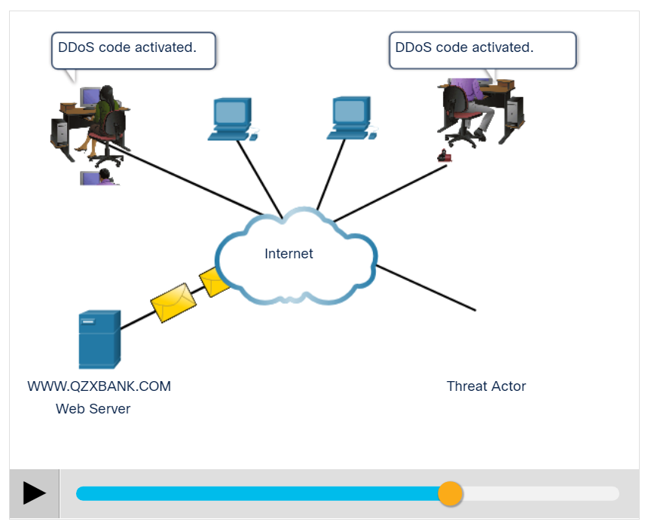
Network Attacks - Denial of Service, Buffer Overflows, and Evasion DoS and DDoS Attacks (Contd.)
DoS Attack: Click Play in the figure to view the animation of a DoS attack.
DDoS Attack: Click Play in the figure to view the animations of a DDoS attack.
Notes:
14 – Common Threats and Attacks
14.3 – Network Attacks - Denial of Service, Buffer Overflows, and Evasion
14.3.2 – DoS and DDoS Attacks

Slide 45
Network Attacks - Denial of Service, Buffer Overflows, and Evasion DoS and DDoS Attacks
A Denial of Service (DoS) attack creates some sort of interruption in network services to users, devices, or applications. The two types of DoS attacks are as follows:
Overwhelming Quantity of Traffic - The threat actor sends an enormous quantity of data at a rate that the network, host, or application cannot handle.
Maliciously Formatted Packets - The threat actor sends a maliciously formatted packet to a host or application and the receiver is unable to handle it.
Notes:
14 – Common Threats and Attacks
14.3 – Network Attacks - Denial of Service, Buffer Overflows, and Evasion
14.3.2 – DoS and DDoS Attacks

Slide 46
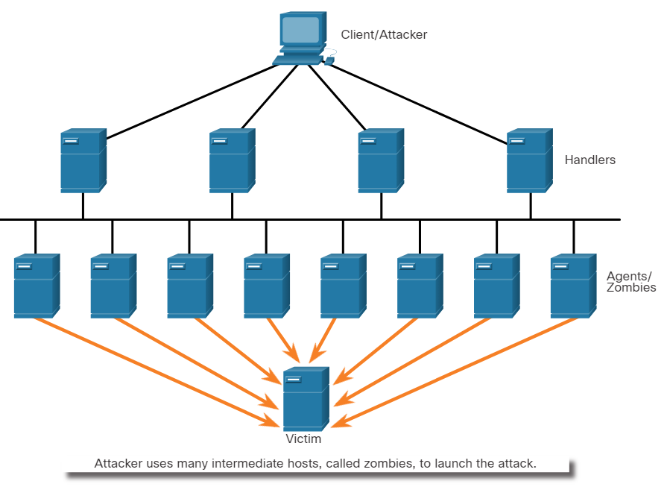
Network Attacks - Denial of Service, Buffer Overflows, and Evasion Components of DDoS Attacks
The following terms are used to describe the components of a DDoS:
Component | Description
zombies | A group of compromised hosts. These hosts run malicious code.
bots | Bots are malware that is designed to infect a host and communicate with a handler system.
botnet | A group of zombies that have been infected using self-propagating malware and are controlled by handlers.
handlers | A master command-and-control (CnC or C2) server controlling groups of zombies.
botmaster | Enables unauthorized file transfer services on end devices.
Notes:
14 – Common Threats and Attacks
14.3 – Network Attacks - Denial of Service, Buffer Overflows, and Evasion
14.3.3 – Components of DDoS Attacks

Slide 47
Network Attacks - Denial of Service, Buffer Overflows, and Evasion Video Demonstration – Mirai Botnet
Mirai is a malware that targeted IoT devices configured with default login information.
The botnet was used as part of a Distributed Denial of Service (DDoS) attack.
Notes:
14 – Common Threats and Attacks
14.3 – Network Attacks - Denial of Service, Buffer Overflows, and Evasion
14.3.4 – Video Demonstration – Mirai Botnet

Slide 48
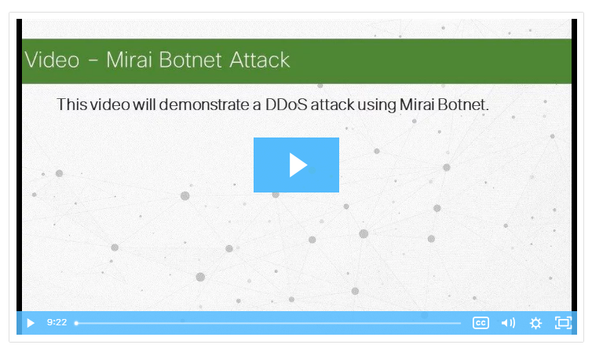
Network Attacks - Denial of Service, Buffer Overflows, and Evasion Video Demonstration – Mirai Botnet (Contd.)
Play the video to view a demonstration of how a botnet-based DDoS attack makes services unavailable.
Notes:
14 – Common Threats and Attacks
14.3 – Network Attacks - Denial of Service, Buffer Overflows, and Evasion
14.3.4 – Video Demonstration – Mirai Botnet

Slide 49
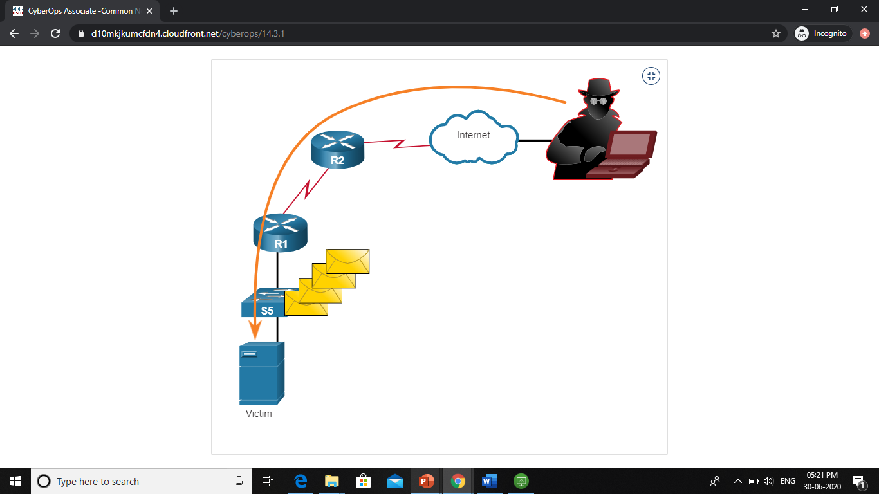
Network Attacks - Denial of Service, Buffer Overflows, and Evasion Buffer Overflow Attack
The threat actor uses the buffer overflow DoS attack to find a system memory-related flaw on a server and exploit it.
For instance, a remote denial of service attack vulnerability was discovered in Microsoft Windows 10, where the threat actor created malicious code to access out-of-scope memory.
Another example is ping of death, where a threat actor sends a ping of death, which is an echo request in an IP packet that is larger than the maximum packet size.
The receiving host cannot handle a packet size and it would crash.
Note: It is estimated that one third of malicious attacks are the result of buffer overflows.
Notes:
14 – Common Threats and Attacks
14.3 – Network Attacks - Denial of Service, Buffer Overflows, and Evasion
14.3.5 – Buffer Overflow Attack

Slide 50
Network Attacks - Denial of Service, Buffer Overflows, and Evasion Evasion Methods
The evasion methods used by threat actors include:
Evasion Method | Description
Encryption and tunneling | This evasion technique uses tunneling to hide, or encryption to scramble, malware files. This makes it difficult for many security detection techniques to detect and identify the malware. Tunneling can mean hiding stolen data inside of legitimate packets.
Resource exhaustion | This evasion technique makes the target host too busy to properly use security detection techniques.
Traffic fragmentation | This evasion technique splits a malicious payload into smaller packets to bypass network security detection. After the fragmented packets bypass the security detection system, the malware is reassembled and may begin sending sensitive data out of the network.
Notes:
14 – Common Threats and Attacks
14.3 – Network Attacks - Denial of Service, Buffer Overflows, and Evasion
14.3.6 – Evasion Methods

Slide 51
Network Attacks - Denial of Service, Buffer Overflows, and Evasion Evasion Methods (Contd.)
Evasion Method | Description
Protocol-level misinterpretation | This evasion technique occurs when network defenses do not properly handle features of a PDU like a checksum or TTL value. This can trick a firewall into ignoring packets that it should check.
Traffic substitution | In this evasion technique, the threat actor attempts to trick an IPS by obfuscating the data in the payload. This is done by encoding it in a different format. For example, the threat actor could use encoded traffic in Unicode instead of ASCII. The IPS does not recognize the true meaning of the data, but the target end system can read the data.
Traffic insertion | Similar to traffic substitution, but the threat actor inserts extra bytes of data in a malicious sequence of data. The IPS rules miss the malicious data, accepting the full sequence of data.
Notes:
14 – Common Threats and Attacks
14.3 – Network Attacks - Denial of Service, Buffer Overflows, and Evasion
14.3.6 –Evasion Methods

Slide 52
Common Threats and Network Attacks - Denial of Service, Buffer Overflows, and Evasion Evasion Methods (Contd.)
Evasion Method | Description
Pivoting | This technique assumes the threat actor has compromised an inside host and wants to expand their access further into the compromised network. An example is a threat actor who has gained access to the administrator password on a compromised host and is attempting to login to another host using the same credentials.
Rootkits | A rootkit is a complex attacker tool used by experienced threat actors. It integrates with the lowest levels of the operating system. When a program attempts to list files, processes, or network connections, the rootkit presents a sanitized version of the output, eliminating any incriminating output. The goal of the rootkit is to completely hide the activities of the attacker on the local system.
Proxies | Network traffic can be redirected through intermediate systems in order to hide the ultimate destination for stolen data. In this way, known command-and-control not be blocked by an enterprise because the proxy destination appears benign. Additionally, if data is being stolen, the destination for the stolen data can be distributed among many proxies, thus not drawing attention to the fact that a single unknown destination is serving as the destination for large amounts of network traffic.
Notes:
14: Common Threats and Attacks
14.3 – Network Attacks - Denial of Service, Buffer Overflows, and Evasion
14.3.6 – Evasion Methods
14.3.7 – Check Your Understanding - Identify the Types of Network Attacks

Slide 53
14.4 Common Threats and Attacks Summary
Notes:
Source:
14 – Common Threats and Attacks
14.4 – Common Threats and Attacks Summary
In-Session Activities / Explanations:
Time: 5 min
Instructor Notes:
Summarise the main points of the module and take the learners through the new terms that they have learned in this module.
Ask them to complete the module quiz present in section 14.4.2.
Key Points: NA

Slide 54
Common Threats and Attacks Summary What Did I Learn in this Module?
Malware is short for malicious software or malicious code.
Most viruses are spread through USB memory drives, CDs, DVDs, network shares, and email.
Trojans are found in online games.
Three common types of malware are virus, worm, and Trojan horse.
Threat actors can also attack the network from outside.
The three major categories are reconnaissance, access, and DoS attacks.
Recon attacks precede access or DoS attacks.
Access attacks exploit known vulnerabilities in authentication services, FTP services, and web services.
DoS attacks create some sort of interruption of network services to users, devices, or applications.
Notes:
14: Common Threats and Attacks
14.4 – Common Threats and Attacks Summary
14.4.1 – What Did I Learn in this Module?

Slide 55
Common Threats and Attacks Summary What Did I Learn in this Module? (Contd.)
DDoS attacks are similar in intent to DoS attacks, except that the DDoS attack increases in magnitude because it originates from multiple, coordinated sources.
Mirai is a malware that targets IoT devices configured with default login information.
The goal of a threat actor when using a buffer overflow DoS attack is to find a system memory-related flaw on a server and exploit it.
Notes:
14: Common Threats and Attacks
14.4 – Common Threats and Attacks Summary
14.4.1 – What Did I Learn in this Module?
14.4.2 – Quiz – Common Threats and Attacks Quiz

Slide 56
Module 14 New Terms and Commands
Social Engineer Toolkit (SET) Denial of Service (DoS) Distributed Denial of Service (DDoS) Buffer Overflows | Mirai Botnet Reconnaissance Attack Access Attack Social Engineering
Notes:
14 – Common Threats and Attackers
New Terms and Commands

